Slide 1
Intelligent design of experiments
Automated experiments
Results
Scientist
Continuous AI
Data
External data
Notes:
Generating/capturing the right data at the right time

Slide 2
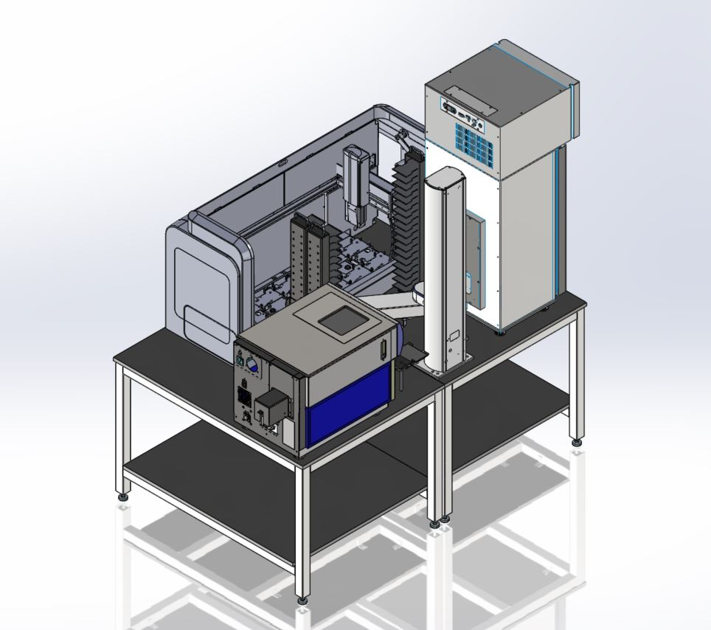
Open Source Cell
profiling lab (v2)
Cell profiling lab (v1)
CPU server
GPU cluster
Storage

